Slide 1


Azure Data Factory Monitoring: You’re doing it wrong
Dieter Gobeyn

Slide 2
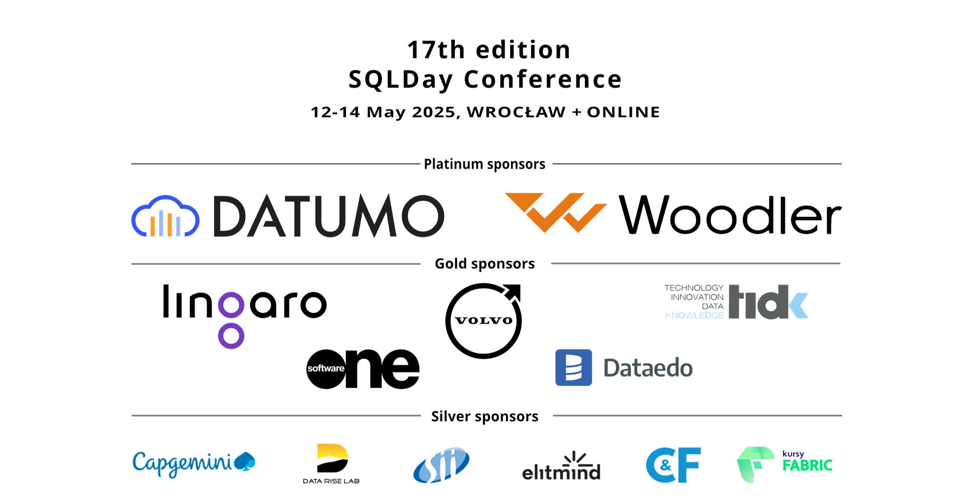

Slide 3

Agenda
Introduction
Monitoring & Observability
Q&A Session
Azure Monitor
Data Factory Specifics
Grafana Integration
Data Factory with Fabric

Slide 4

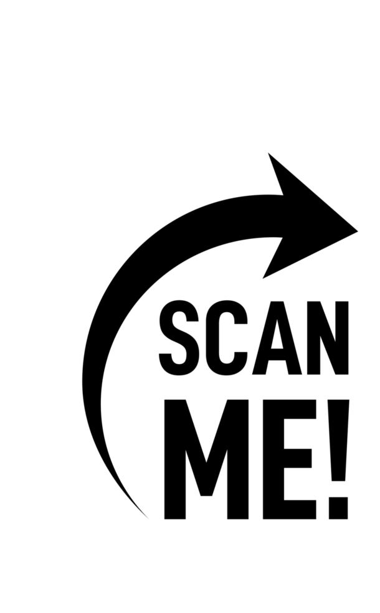
Dieter Gobeyn
Azure MVP - hands-on Azure Cloud Solutions Architect & Azure certified since 2012
Passionate about Cloud & Integration
Belgian-born, now based in London
Scuba diver - hiker – world traveler
Public speaker and blogger

Slide 5
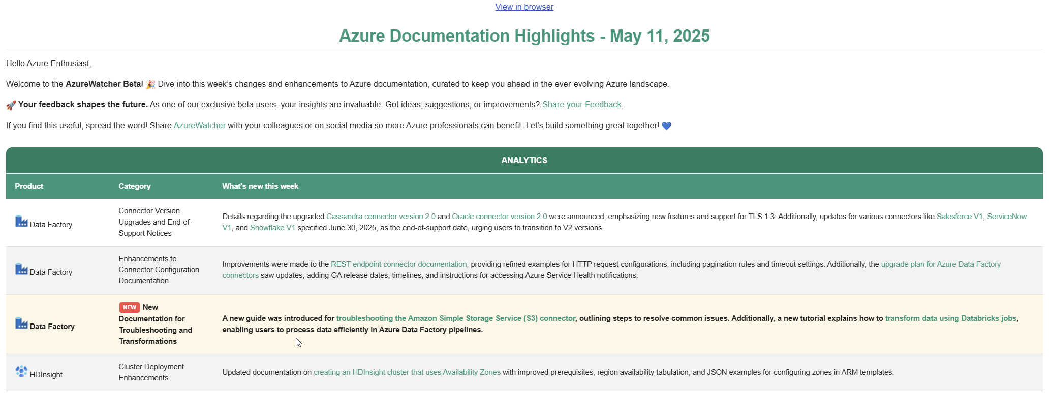
https://azurewatcher.com

Slide 6
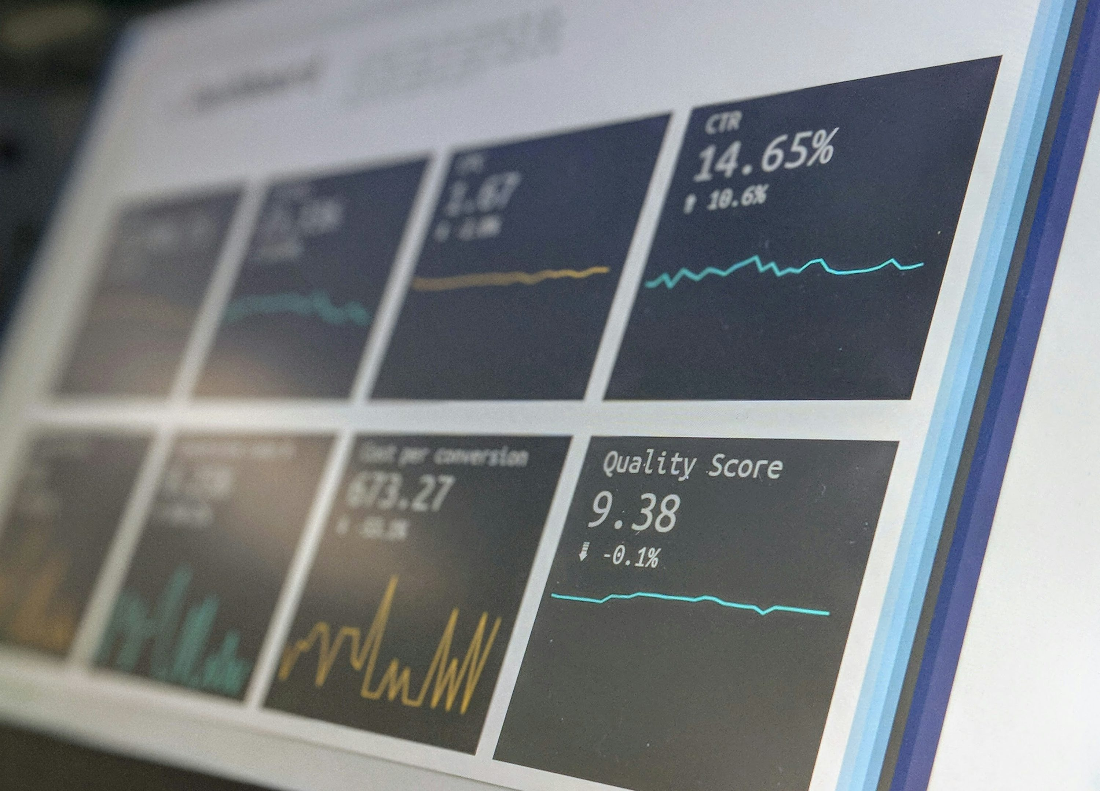
Modern Challenges in Monitoring Azure Applications
Complex, distributed (integrated) services
Too much raw data, few insights
Hard to trace pipeline failures
Risk of alert fatigue
Balancing scale and cost

Slide 8
Demo
Walk through pipelines demo setup
DF metrics

Slide 9
What is Azure Monitor?
Azure’s built-in platform for collecting, analysing, and acting on telemetry data
Helps you detect and fix issues faster
Monitors applications, infrastructure, and networks
Supports alerts, dashboards, and automated actions

Slide 10
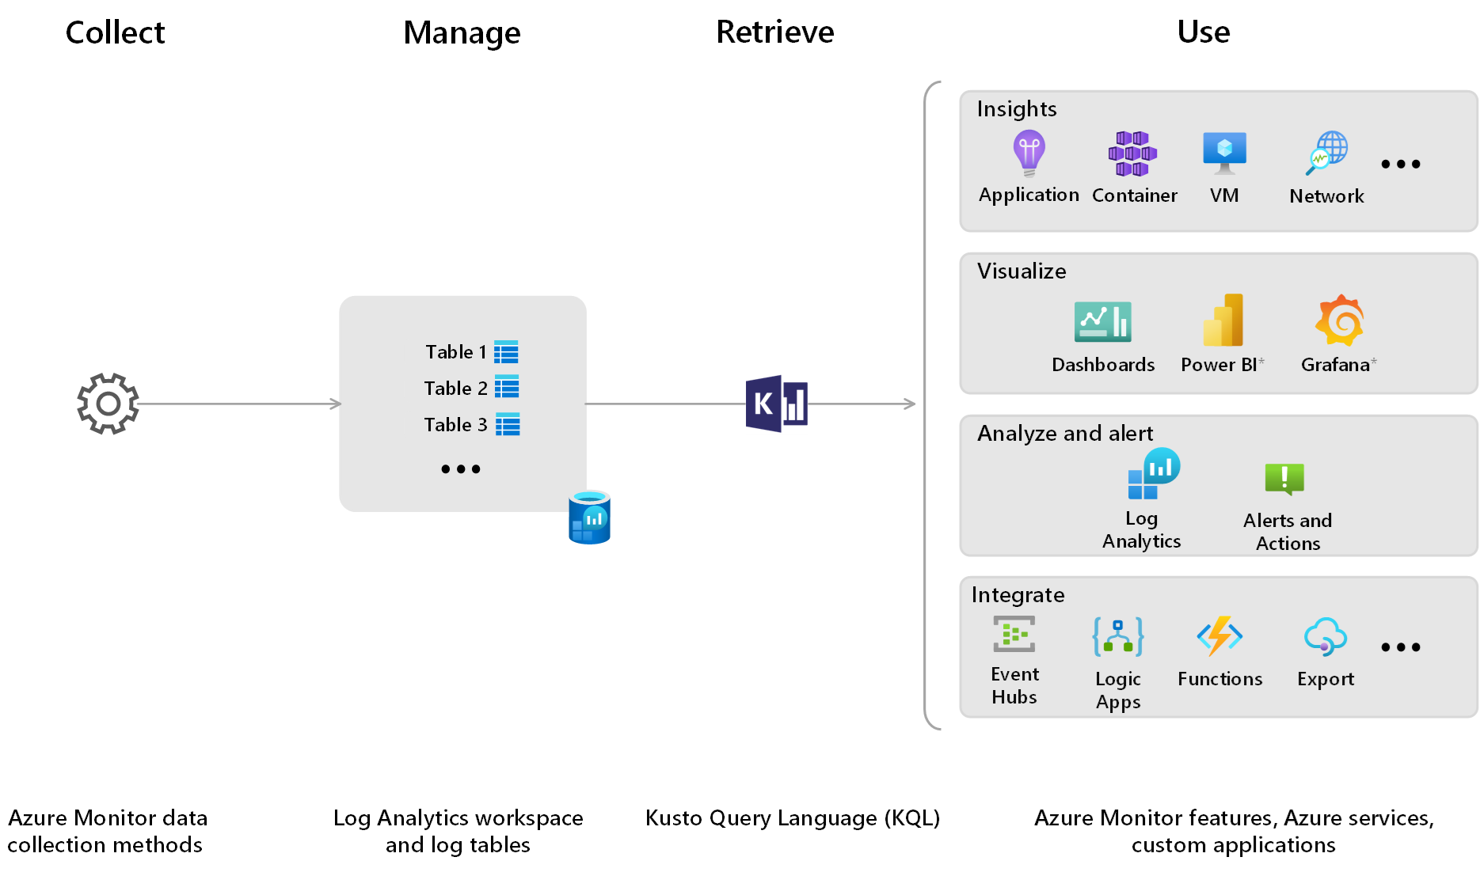
How Azure Monitor Logs works
Collect: ingest and transform any telemetry, then send it to Log Analytics tables
Manage: set schemas, retention, access, and spend in your workspace
Query: get near-real-time insights with KQL or simple no-code views
Act: drive analysis, troubleshooting, alerts, dashboards, and integrations

Slide 11

Azure Monitor for data factory
Azure Monitor Integration: Track pipeline runs, trigger runs, and activities.
Built-in Monitoring: Use the ADF portal for quick views and manual checks.
Alerts: Set up alerts for failures, long runs, or custom conditions.
Metrics and Logs: Collect detailed operational data for analysis.
Visual Tools: Use dashboards, activity runs, and Gantt charts for easier troubleshooting.
Automated Actions: Trigger Logic Apps or Functions based on alerts.

Slide 12
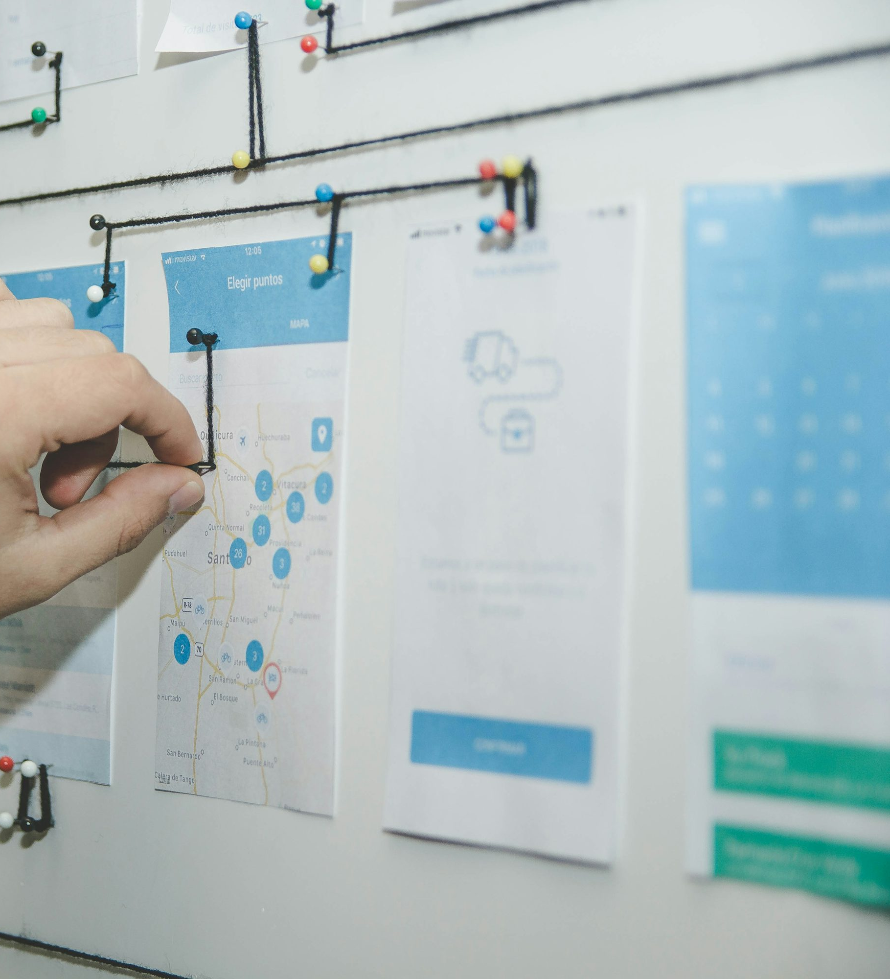
Monitoring Data Factory with Azure Monitor
Some ideas:
Track Correlation ID or business Keys: Capture full pipeline flow in one KQL view based on OrderId, ShippingId, or CustomerReference.
SLA Dashboards: Show on-time, delayed, or failed loads using Azure Monitor Workbooks
Row-Count Alerts: Warn if load is too small
Automatic Incident Creation: Raise ServiceNow or Jira tickets after repeated failures

Slide 13
Enhancing Data Logs with Annotations and User Properties in Data Factory
Annotations
Static tags added to pipelines, activities, datasets, and linked services
Help organise and group objects for easier searching and reporting
Useful for documentation, ownership tags, project grouping
User Properties
Dynamic values set during pipeline execution
Logged automatically in Azure Monitor and Log Analytics
Useful for tracking run-time data like file names, record counts, Correlation IDs or business keys (OrderId, CustomerRef, ShippingId)
Goal: Better log organisation, easier monitoring, faster troubleshooting

Slide 14
Demo
Annotations and user properties
Log Analytics
KQL queries
Create alert from KQL
Pin to dashboard

Slide 15
KQL Queries
ADFPipelineRun
| where Status == 'Failed'
ADFPipelineRun
| extend Owner = parse_json(Annotations)[0]
| where Status == 'Failed'
ADFPipelineRun
| where Status <> 'Queued' and Status <> 'InProgress'
| extend StatusLight = case(
Status == "Failed", "🔴",
Status == "Succeeded", "🟢",
"🟡" // default if neither Failed nor Succeeded
)
ADFPipelineRun
| where Status <> 'Queued' and Status <> 'InProgress'
| extend StatusLight = case(
Status == "Failed", "🔴",
Status == "Succeeded", "🟢",
"🟡" // default if neither Failed nor Succeeded
)
| project TimeGenerated, StatusLight, OperationName, CorrelationId, Annotations, Start, End
| order by TimeGenerated desc
ADFActivityRun
| project TimeGenerated, Status, PipelineName,CorrelationId, Quote=parse_json(UserProperties).QuoteValue
| where Status == 'Succeeded' and PipelineName == 'GetQuotePipeline' and Quote <> ''
| order by TimeGenerated asc

Slide 16
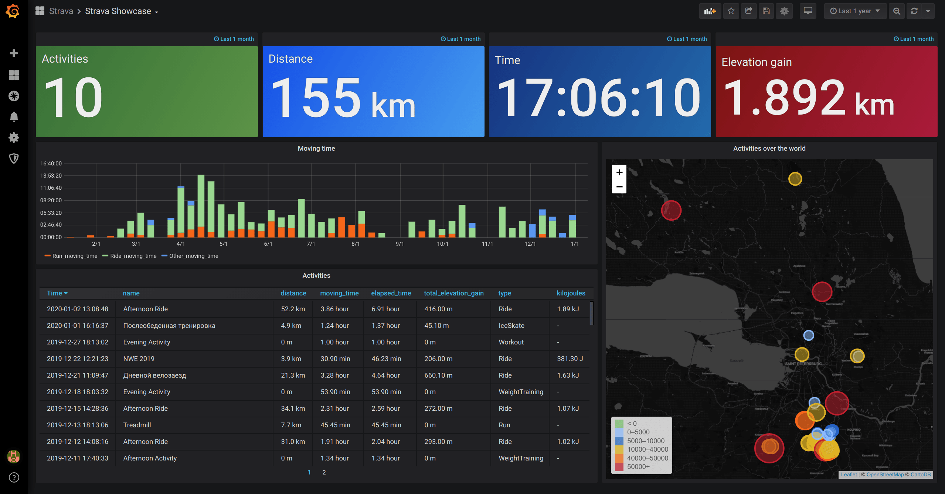
What is Grafana?
Open platform for analytics and monitoring, but also directly available from Azure portal
One of the leading open source software for time series analytics
No matter where your data is, what kind of dashboard is lives, you can build dashboards using Grafana

Slide 17

Monitoring Azure with Grafana
Azure Monitor Plugin: Connects Grafana to Azure Monitor Metrics, Logs, Traces, and Resource Graph for comprehensive data access.
Azure Managed Grafana: A fully managed service that integrates seamlessly with Azure, offering features like Microsoft Entra ID authentication and the ability to pin Azure charts directly to Grafana dashboards. (Shift from PowerBi)
Out-of-the-Box Dashboards: Leverage prebuilt dashboards for services like Azure Monitor to accelerate setup.​

Slide 18
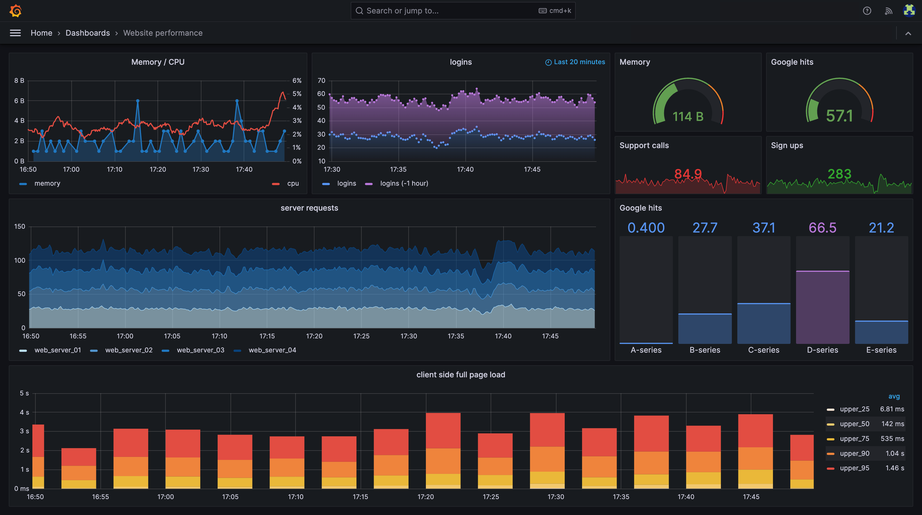
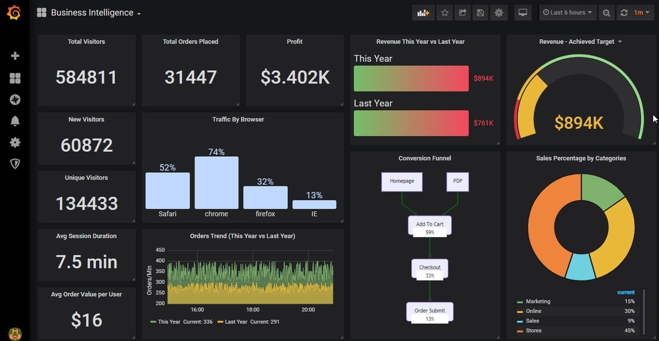
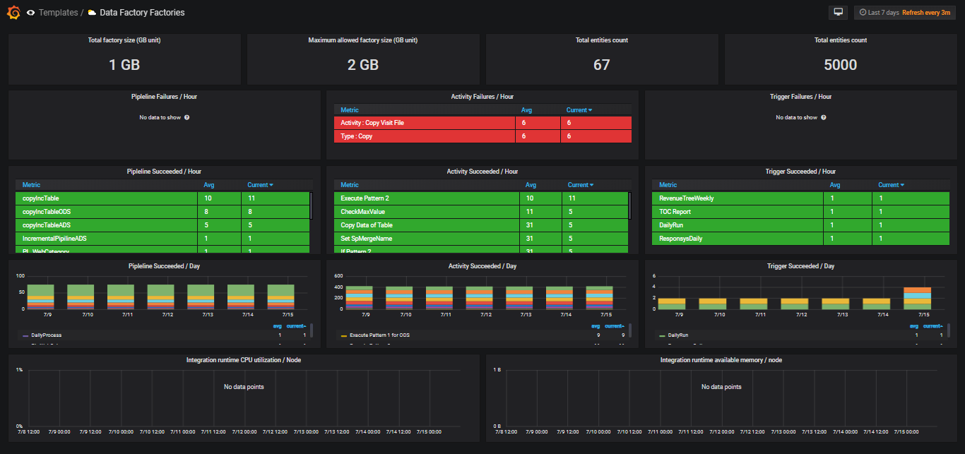
Notes:
https://dietergobeyn1.grafana.net/d/data-factory-factories/azure-data-factory-factories?orgId=1&from=now-7d&to=now&timezone=browser&var-Subscription=aek2b99e0m60we&var-ResourceGroup=&var-ResourceName=&refresh=1m

Slide 19
Demo
Managed Grafana
Grafana walkaround

Slide 20
What about Fabric? ☺
Azure monitor and diagnostic settings are not only applicable to DF, but to all Azure resources.
Key Differences Compared to Data Factory:
In Fabric, diagnostics focus heavily on cluster health, node status, application lifecycle, and infrastructure events.
Azure Data Factory primarily logs pipeline runs, activity execution, and trigger status. It uses simpler metrics compared to the deeper, system-level telemetry of Service Fabric.
More information: https://learn.microsoft.com/en-us/azure/service-fabric/monitor-service-fabric

Slide 21
Resources
Analyze monitoring data with Kusto Query Language: https://learn.microsoft.com/en-us/training/paths/analyze-monitoring-data-with-kql/
Azure & Grafana: https://learn.microsoft.com/en-us/azure/azure-monitor/visualize/grafana-plugin
Azure managed Grafana: https://azure.microsoft.com/en-us/products/managed-grafana
Data factory template: https://github.com/yesoreyeram/grafana-dashboards?tab=readme-ov-file
Diagnostics in Azure Data Factory: Leveraging User Properties and KQL: https://azuretechinsider.com/azure-data-factory-user-properties-and-kql/

Slide 22
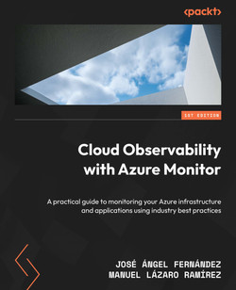

Slide 23

Q&A Session
Open forum for questions and clarifications

